Slide 1

General Overview
© 2022, Amazon Web Services, Inc. or its Affiliates. All rights reserved. Amazon Confidential and Trademark

Slide 2

Making hardware is hard.
“

Slide 3
Design / Time / Cost /
Manufacturing / Expertise/
Regulations

Slide 4

Connected hardware is harder
Even more expertise
Networking
Security
Provisioning
Maintenance
Cloud Infrastructure

Slide 5
SimpleIOT
A simple, intuitive system for
creating and managing
the lifecycle of
cloud-connected devices.

Slide 6
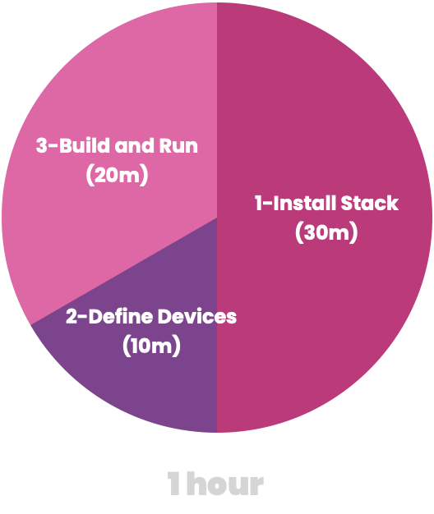
Save Development Time

Slide 7

Reduce Operational Costs
No server hardware to install
No application-server to maintain
100% serverless code
Auto-scale from 1 to millions
Pay-as-you-go

Slide 8

Save on Maintenance Costs
Live device fleet status
Run remote device diagnostics
Remote firmware updates
Enable predictive failure detection

Slide 9

Standardize Development Across Products
Includes cloud software, firmware, and mobile development tools.
Post-sale monitoring
Regulatory reports

Slide 10

Unlock New Business Models
Subscription
Pay-as-you-go
Metered
Replenishable
Unlock features via firmware updates
Anonymized usage data collection

Slide 11
Connected Device Lifecycle
Create
Design Iteration
Build
Concept
Define
Design
Prototype
Integrate
Test/QA
Certify
New Features
Monitor + Maintain
Distribute
Improve
FW/Update
Customer
Support
Mass-Produce
End-of-life
Recall
Recycle
Retire
Repair
Monitor / Visualize
Deploy
Sales
Distribute
Dispose
Refurbish
Replace
Amazon for
Business
Re-provision

Slide 12
Let’s simplify
Design
Build
Test
Deploy
Monitor

Slide 13
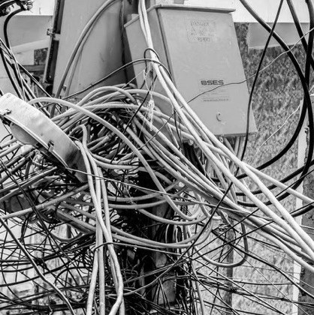

Even this is too complex
Firmware
Protocol
Cloud Services
Encryption
Mobile
Gateway
Load Balancer
OTA update
Security
Analytics
Wireless
Digital Twin

Slide 14
Basic Concepts
Project
DataType
battery: float : %
Model
DataType
temperature: int : C
Data: temperature
Value: 28
Device
Serial: SN-000001
Data: battery
Value: 89

Slide 15




Common Building Patterns
Direct
Wearables
Cloud Service
Cloud Service
On-site Installation
Logistics
Gateway
Cloud Service
Cloud Service

Slide 16

Don’t Repeat Yourself
Remove undifferentiated heavy lifting
Adopt best practices
Rely on community of experts
Focus on unique product features

Slide 17

In your own private cloud

Slide 18

Own all your data

Slide 19

With room for future growth
Secure over-the-air updates
AI / ML
Data analytics
Anomaly detection
AR / VR

Slide 20
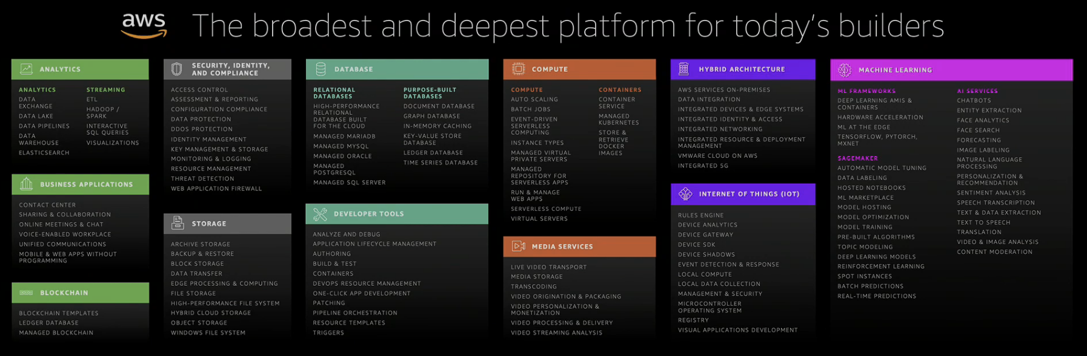
Backed by AWS

Slide 21
Flow of Information
Analytics Kinesis EMR
Artificial intelligence Elastic Map Reduce Sagemaker Rekognition
Database Redshift
Management tools CloudWatch
AWS IoT
Devices
Cloud
Intelligence

Slide 22

End-to-end security
Virtual Private Clouds
X.509 public-key encryption
TLS/SSL
Crypto-engines
Encrypted databases

Slide 23



Actionable Intelligence
Data
Insight
Outcome

Slide 24
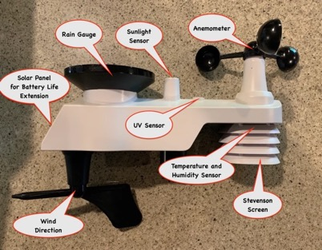
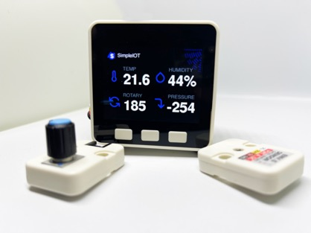
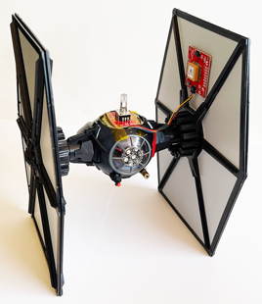
Engineering Examples Provided
Remote
Weather Station
Andon Light
Control
M5 SensorKit
Tie-Fighter
Sensor + IMU – Light/Laser control + GPS

Slide 25
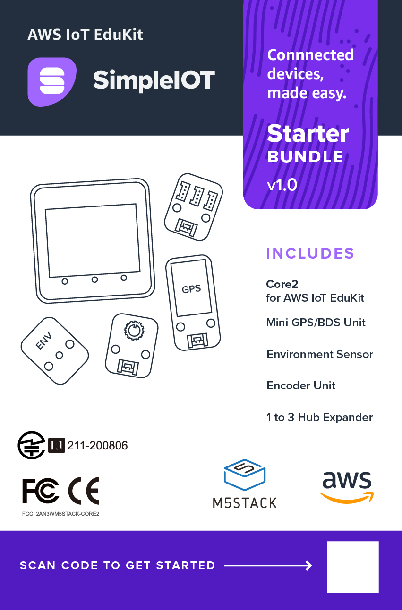
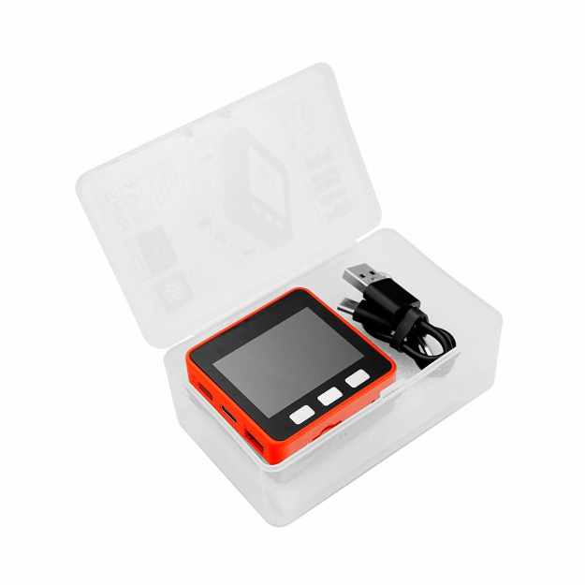
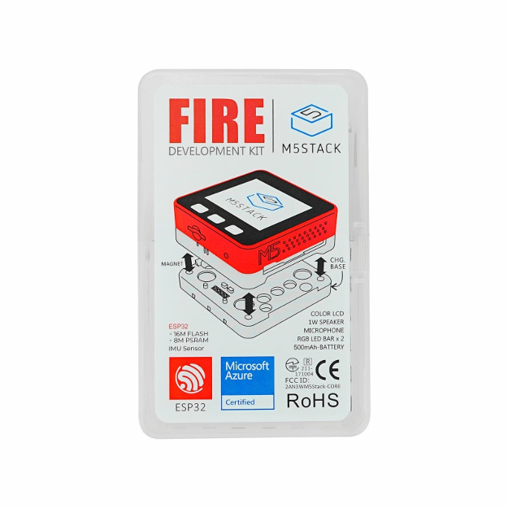
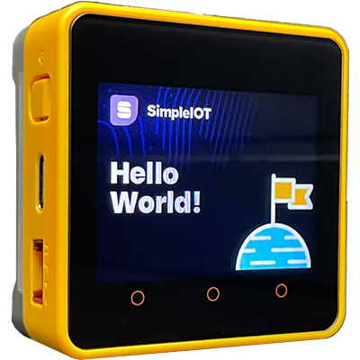
Custom Hardware Kit
AWS IoT EduKit

Slide 26
Applications
Connected Hardware (consumer, B2B, industrial)
Store of the Future (and vendors)
Hardware/Integrators (company-wide standards)
Logistic supply chain
Medical Equipment

Slide 27


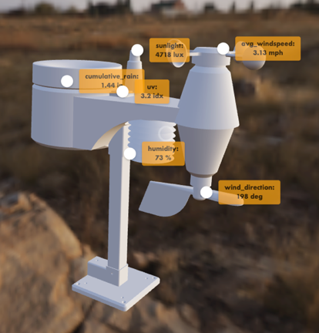

Live-3D Digital Twin Examples

Slide 28
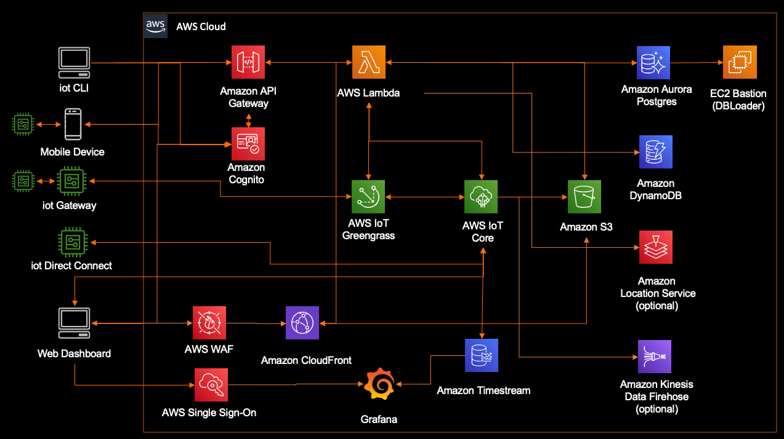
SimpleIOT Architecture

Slide 29
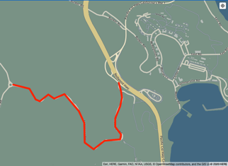
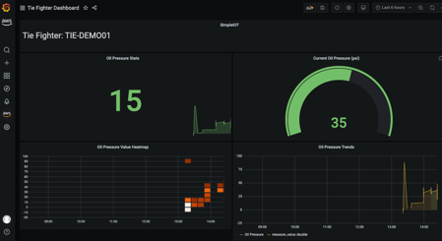
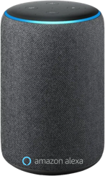



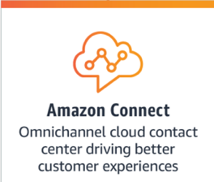
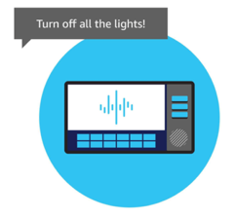
Upcoming Services

Slide 30
100% Open Source

Slide 31
Let’s Invent Together…

Slide 32
Data Channel Partitioning
MQTT
Device
Device
Processing
/hw/…
/sys/…
System Firmware
AWS
IOT
Sensor
Device
/adm/…
Application
User/App
Processing
/app/…
/user/…
User Data
Data/Control stream separation
for compliance, i.e. HIPPA

Slide 33
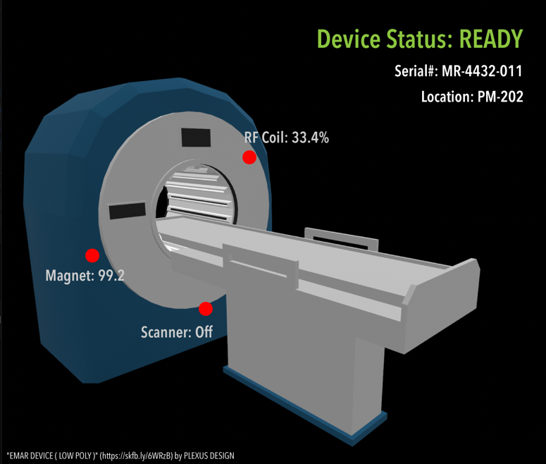
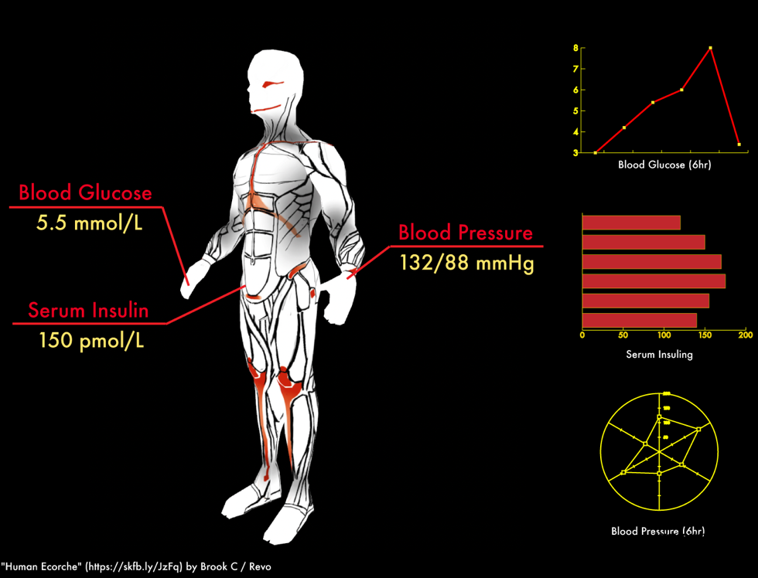
Medical Applications 3D Twins
Patients
Devices

Slide 34
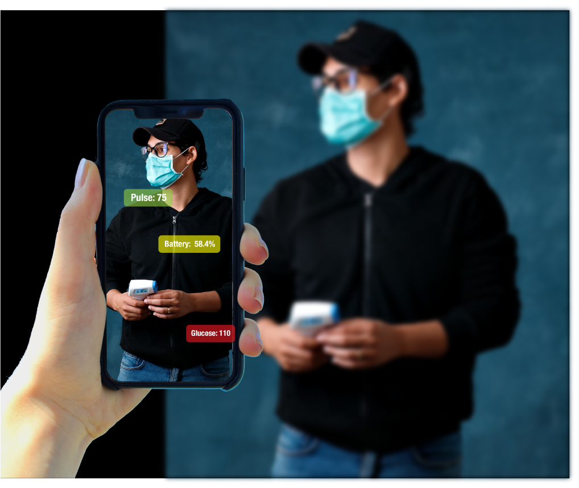
Medical AR Applications

Slide 35
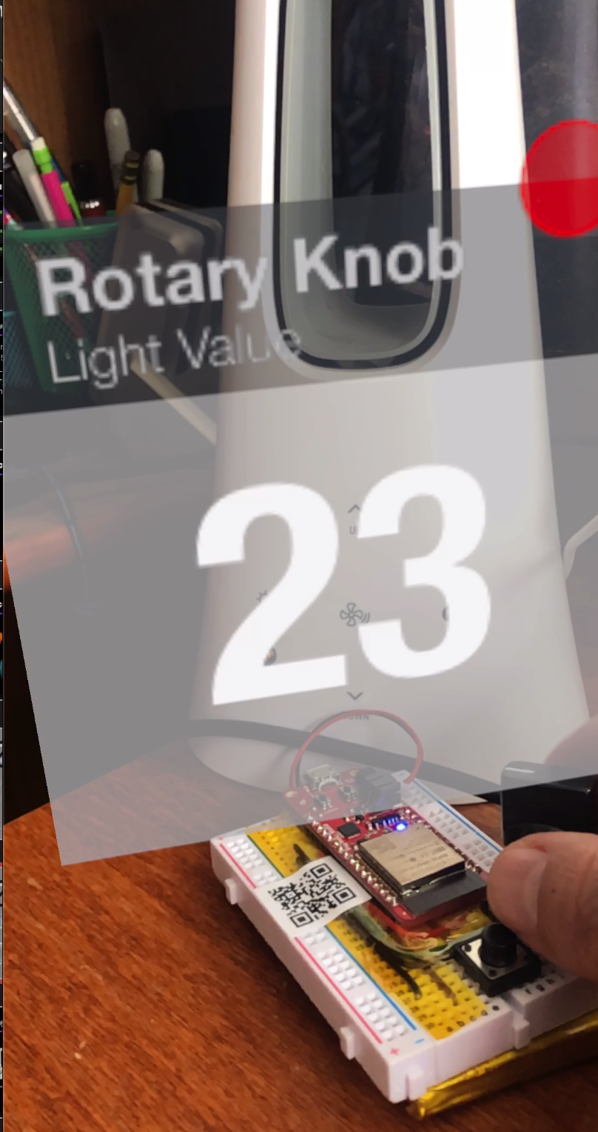
Headless (AR) Device Interface

Slide 36
Multi-Tennant Architecture – individual accounts
Customer 1
Customer 2
Customer 3
IOT
API
Dashboard
IOT
API
Dashboard
IOT
API
Dashboard
Lambda
Database
Events/Rules
Lambda
Database
Events/Rules
Lambda
Database
Events/Rules
AI/ML
User/Auth
Notification
AI/ML
User/Auth
Notification
AI/ML
User/Auth
Notification
Reporting
Analytics
Repairs
Reporting
Analytics
Repairs
Reporting
Analytics
Repairs
Common Management Service
Management
Billing
Deployment
Device Integration
Monitoring
Consulting/PS
Data Analytics
Industry
Verticals
Development

Slide 37
Data Publishing
Subscribers
Database
Chart
Sensors
Raw Data
Subscription Feed
Dashboard
@raw
HW Device
Data
Storage
Insights
Subscription Feed
@insight
Mobile
push/sms
Rules AI/ML
Actionable
Events
Subscription Feed
@event
Social Media
Logs
Feedback
Loop

